Slide 1








Main Page
Text to be provided

Slide 2



Page 1 – E-Book Stores
Replace:
Main Banner
I Love Reading
Jsim
Shing Lee
Benjo & Son
Natura Craft

Slide 3


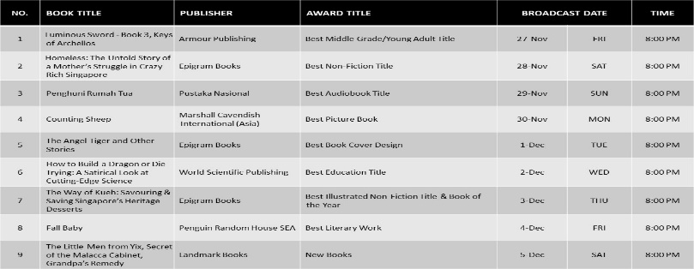

Page 2 - Showcase
Broadcast schedule
Replace:
Main Banner
Landmark
Insert:
Text
Schedule

Slide 4

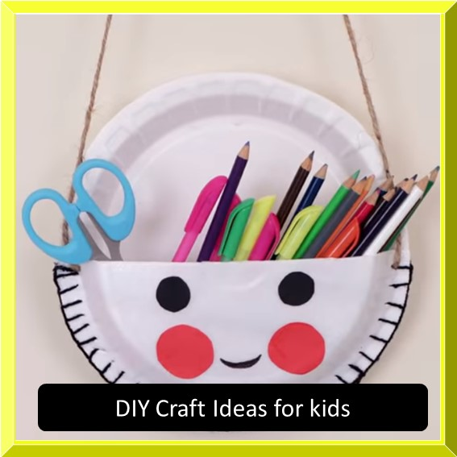
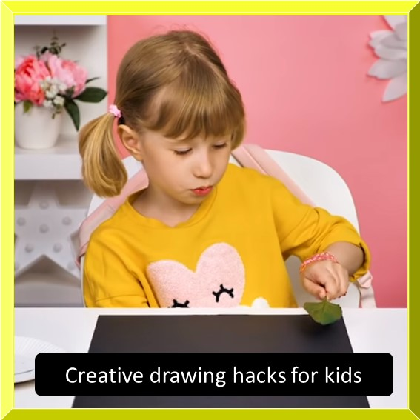
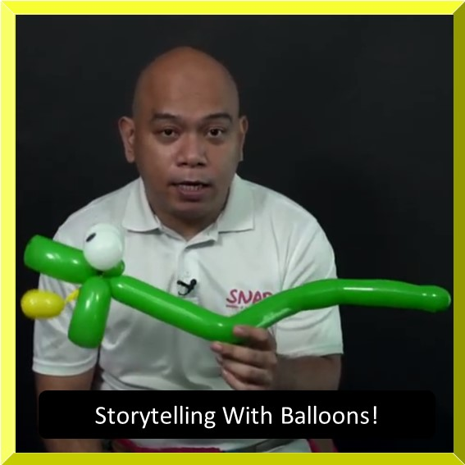
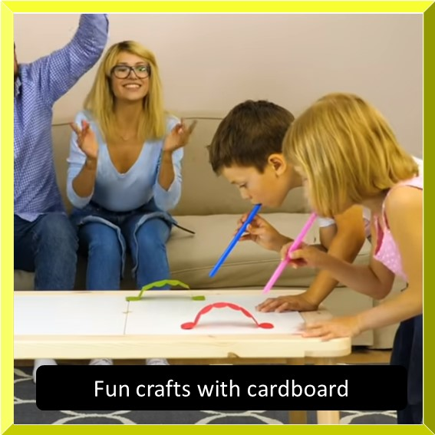
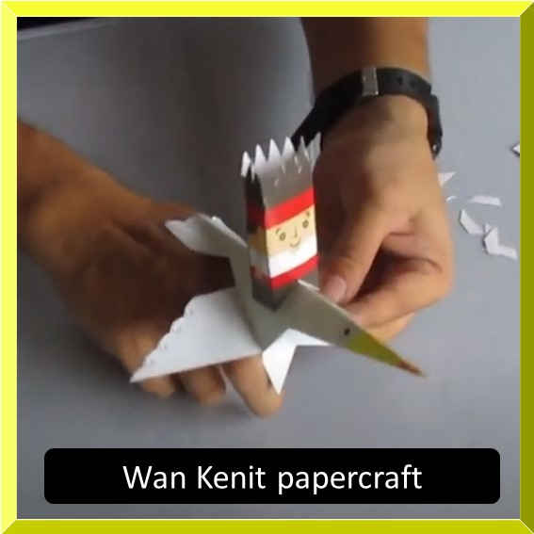
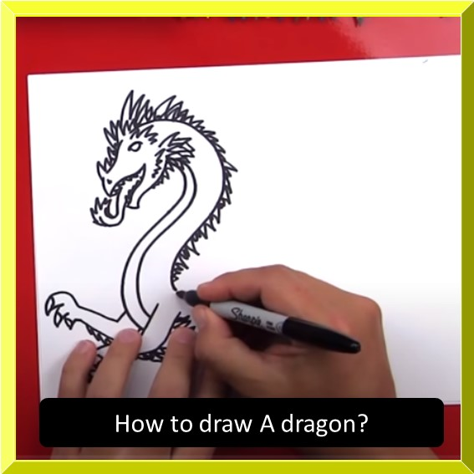
Page 3 - Activities
Replace:
Main Banner
Replace icon 3
Replace icon 6
(take note the link change)

Slide 5


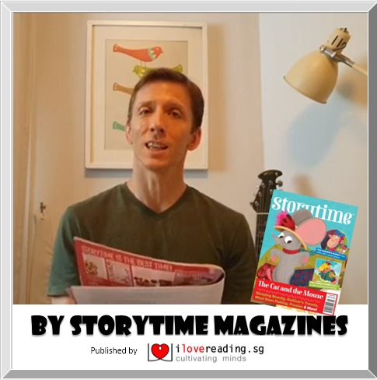

Page 4 - Events
Change everything
TBA
TBA

Slide 6





Page 6
TEXT TO BE SUPPLIED
Change everything

Slide 7




Page 7
Text to be provided
Replace
Creating Video – wrong timing
INSTRUCTION:
Link to google form: https://forms.gle/HyJC3tecRpPQcvi57

